Slide 1
Generalized Trainable Activation Functions in Neural Networks
Aaron Davis - December 5, 2022

Slide 2
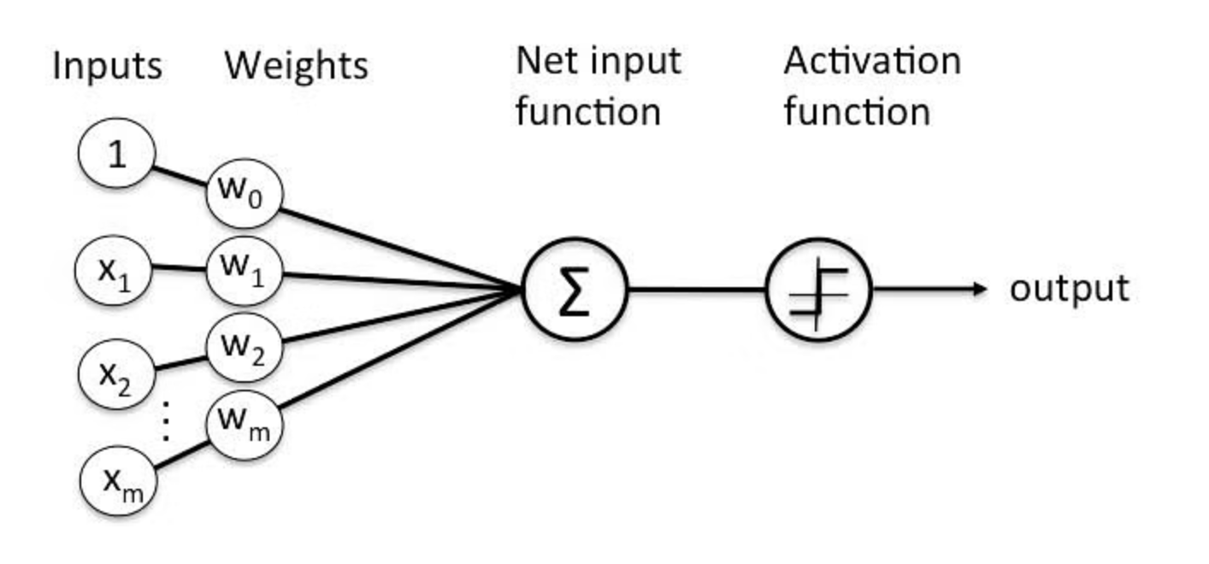
Introduction to Activation Functions
Y = Activation(Sum(w_i * x_i) + bias)

Slide 3
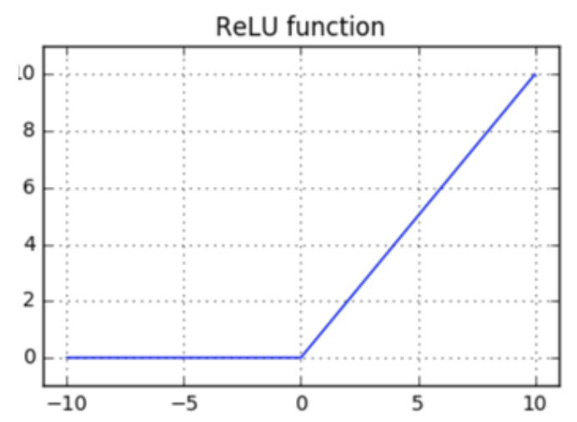
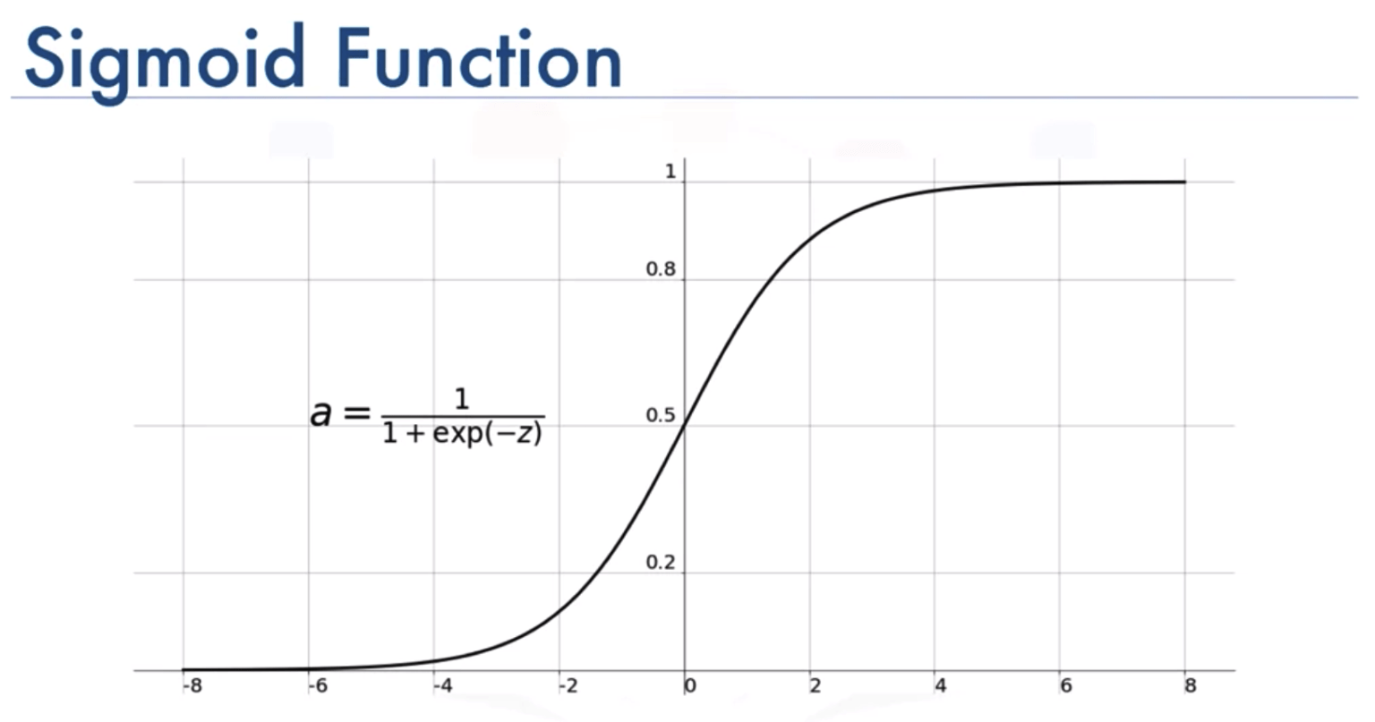
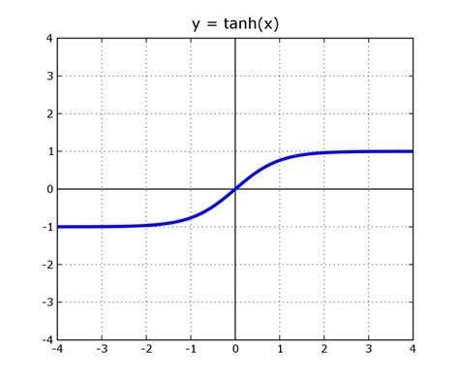
Commonly Used Activation Functions

Slide 4
But what if we let the network
learn an activation function?

Slide 5
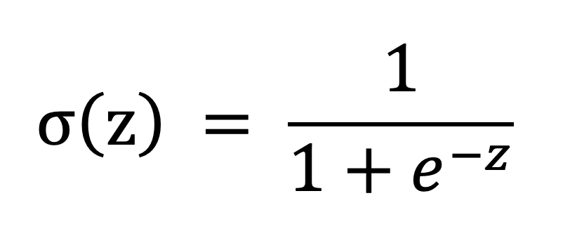
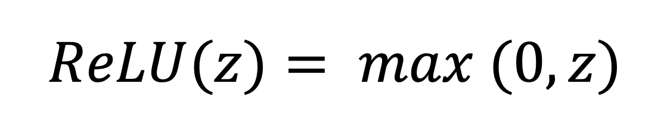
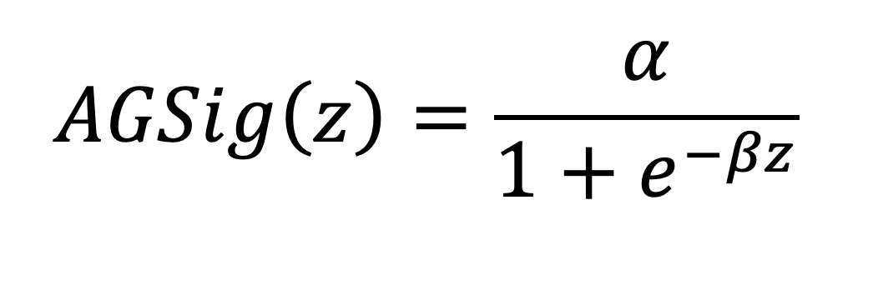
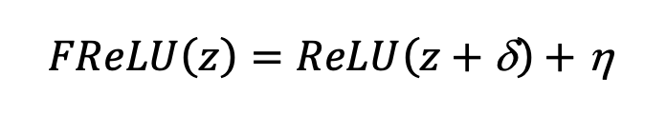
Research about Trainable Activations
Reference 1
Reference 2

Slide 6
But these activations still assume a functional form …

Slide 7
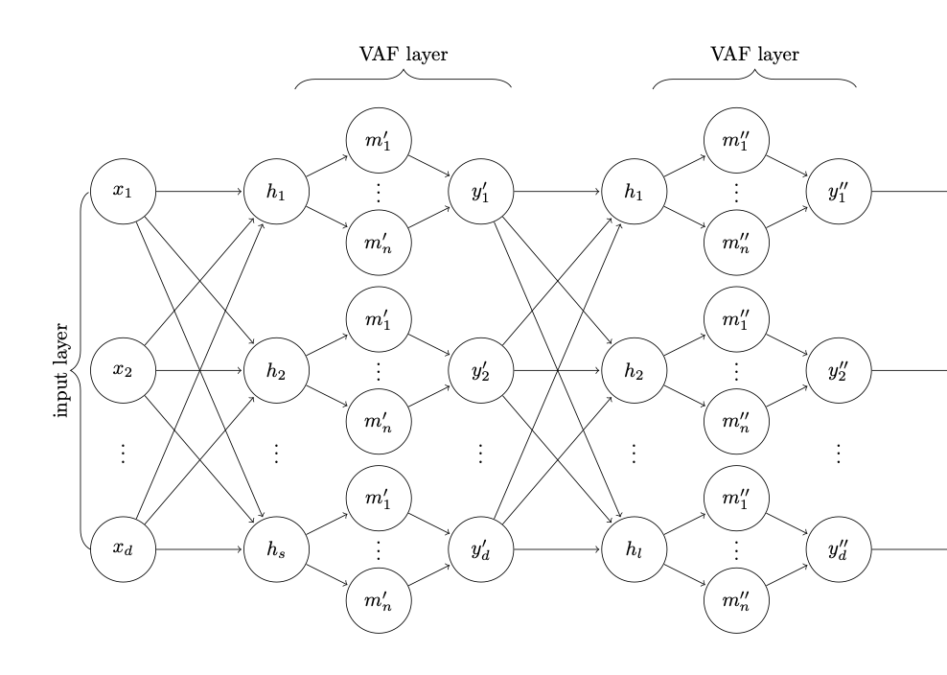
Variable Activation Functions (VAF)
Apicella, et al. [3]

Slide 8
Variable Activation Functions (Continued)
Assumptions of VAF
Each subnetwork has only one hidden layer
The input and output neuron for each subnetwork uses a linear activation (or simply a sum with a bias).

Slide 9
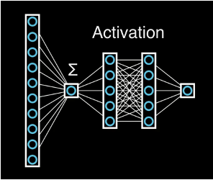
Meta-Neurons (My Work)
Generalized Variable Activation Functions
Uses similar subnetwork architecture to train activation functions
Does not constrain subnetworks to a single hidden layer. Introduces residual connections within subnetworks to avoid training issues with deep networks without residual connections.
Allows for input and output non-linear activations for each subnetwork.

Slide 10
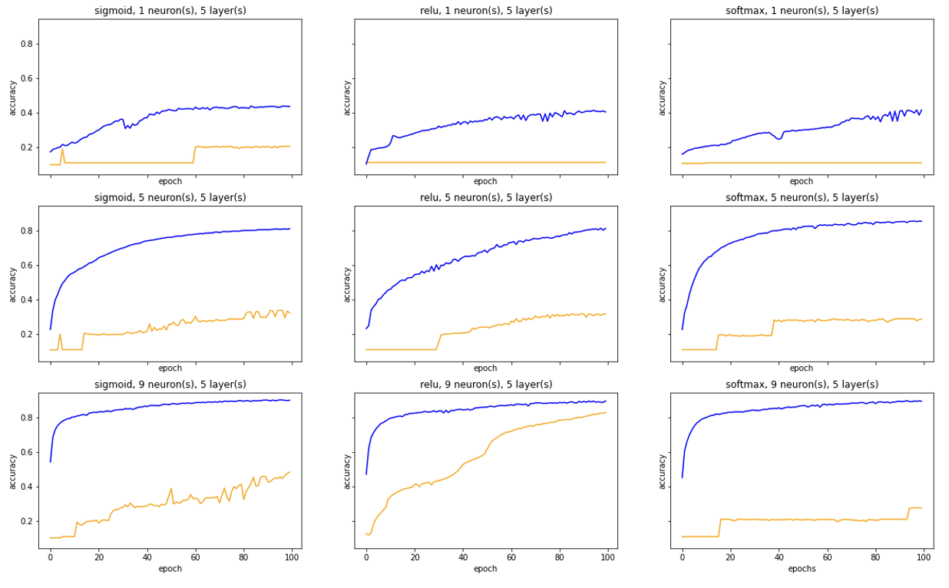
Meta-Neuron Networks vs. Networks w/ Fixed Activations on MNIST Dataset
(Blue uses meta-neurons, Orange does not.)

Slide 11
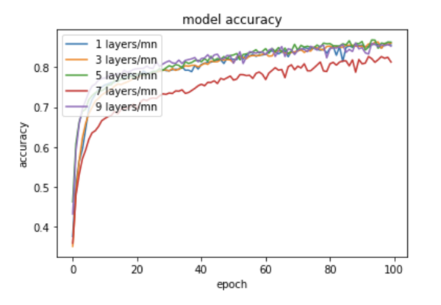
Optimal Meta-Neuron Network Parameters
For MNIST data

Slide 12
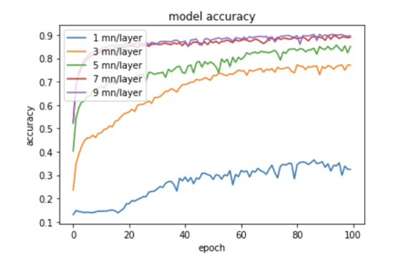
Optimal Meta-Neuron Network Parameters
For MNIST data

Slide 13
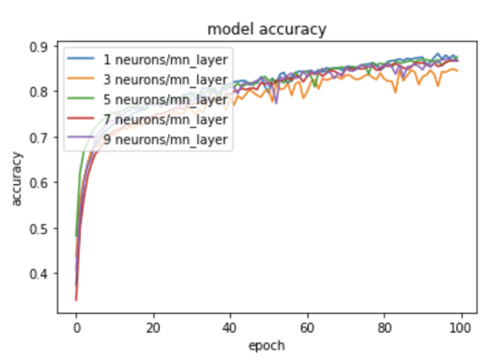
Optimal Meta-Neuron Network Parameters
For MNIST data

Slide 14
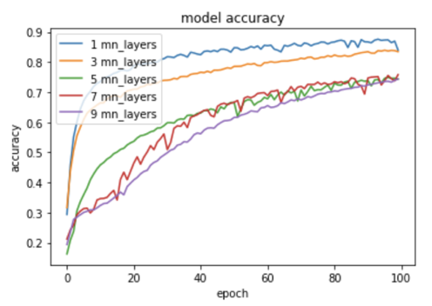
Optimal Meta-Neuron Network Parameters
For MNIST data

Slide 15
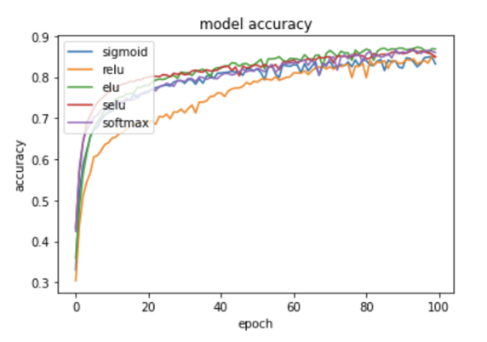
Optimal Meta-Neuron Network Parameters
For MNIST data

Slide 16
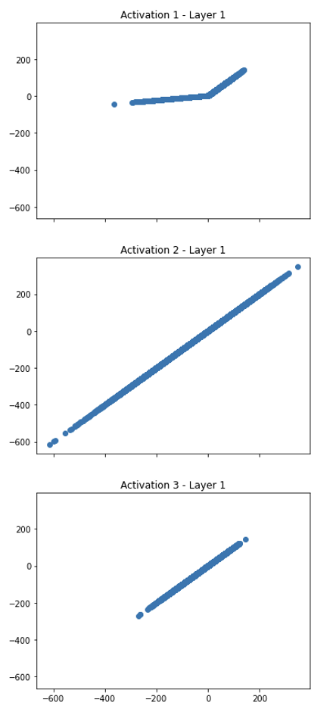
Visualizing Trained Activations
For MNIST data, with single layer, 3 meta-neuron ANN

Slide 17
Future Work
Collapse learned activations down into fixed representations to cut down on computing cost at inference time.
Identify learned linear activation functions, and simply replace them with multiplication by a constant. This seems similar to network pruning.
Compare Meta-Neuron performance to simpler trained activations, like FReLU and AGsig.
Evaluate changes in accuracy vs computing power for large networks.

Slide 18
Conclusion
Generalized trainable activation functions seem to help increase model accuracy and convergence speed relative to models with the same architecture but using fixed activations. So try using trainable activations!
Resources to get started:
Parametric ReLU (https://keras.io/api/layers/activation_layers/prelu/)
See References

Slide 19
References
[1] Hu, Z. "The study of neural network adaptive control systems." Control and Decision 7 (1992): 361-366
[2] Qiu, Suo, Xiangmin Xu, and Bolun Cai. "FReLU: flexible rectified linear units for improving convolutional neural networks." 2018 24th international conference on pattern recognition (icpr). IEEE, 2018
[3] Apicella, Andrea, Francesco Isgrò, and Roberto Prevete. "A simple and efficient architecture for trainable activation functions." Neurocomputing 370 (2019): 1-15.

